Slide 1
EUMIND 2016: GO GREEN ECOLOGICAL COMPANIES

Slide 2
KHADI and village Industries commission
Visit Report and Summary

Slide 3
AN INTRODUCTION TO KHADI, HOW IT CAME about:
Khadi is a central governmental organization. Khadi means cloth. Khadi was started by Gandhiji. After Independence, uneducated people had a lot of problems and they now had nothing to do. Hence Gandhiji decided to give these people employment in cloth manufacturing industry. These people made Khadi clothes through a charkha or a simple spinning wheel, hence giving rise to Khadi Industry.
When India was under the British rule, almost all parents wanted their children to participate in the war.After Independence, uneducated people had a lot of problems. Before the independence, they were always engaged in doing something or the other for the nation. But now they had nothing to do. Hence Gandhi Ji decidedto give these people employment in cloth manufacturing industry. These people made KHADI clothes through a charkha. Hence giving rise to KHADI Industry.

Slide 4
THE CLASSICAL CHARKhA

Slide 5
PRODUCTS MANUFACTURED BY KVIC:
Khadi Clothes made from silk, cotton, muslin or wool. This also includes Polyvastra Khadi. Silk is obtained without killing the cocoons.
Leather products like Kolhapuri chappals, sandals, shoes and purses. This leather is only taken from dead animals who have died naturally.
Fibre utility items are made out of Sisal Banana, Pineapple, Palm and other fibres. Incense sticks with fragrance are available in different varieties.
Processed Fruit: Products like Mango pulp, tomato pulp, etc. can be exported in large quantity. The products are covered under FPO (Food Product organisation) license.

Slide 6
CONTD..
Honey is a natural sweet syrup collected by honey bees. Honey is also used as cough syrup, blood purifier and also as a general tonic. There are bee boxes made in which the bees make their honey and thus the honey is taken in such a way that no bees are harmed.
Hand Made Paper: This is a beautiful product uses the pulp made from crushed cloth rags and waste paper as raw material for production thus contributing in saving the trees, and hence preservation of ecology. It is environment friendly as it does not use wood pulp as raw materials and hence save trees. It also converts waste into wealth, recycling nature.
Biogas using animal and human excreta.
Other products from bees like propolis, wax, pollen, venom and royal jelly.

Slide 7
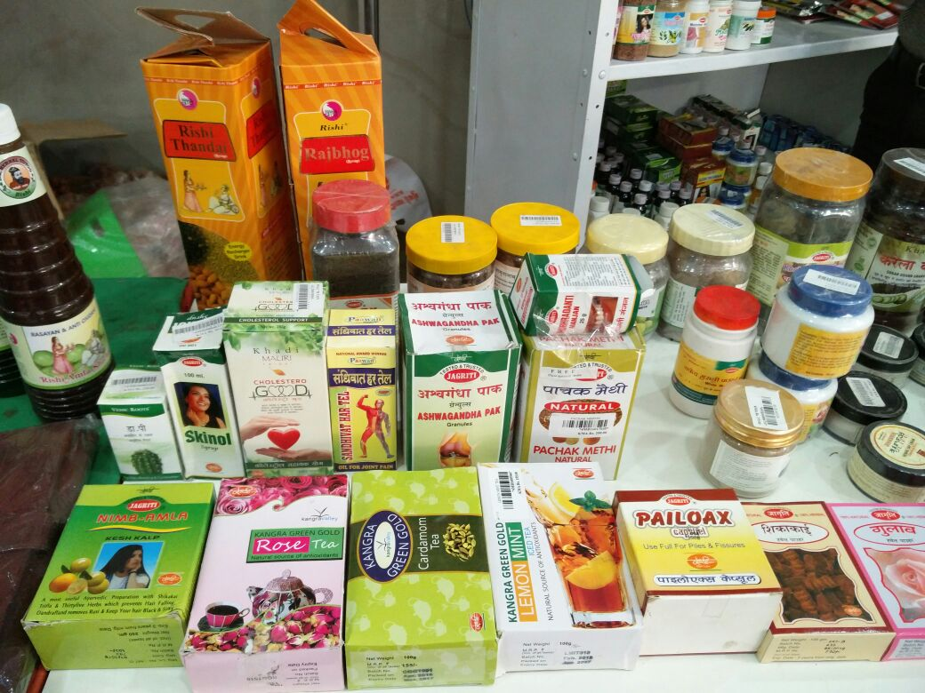
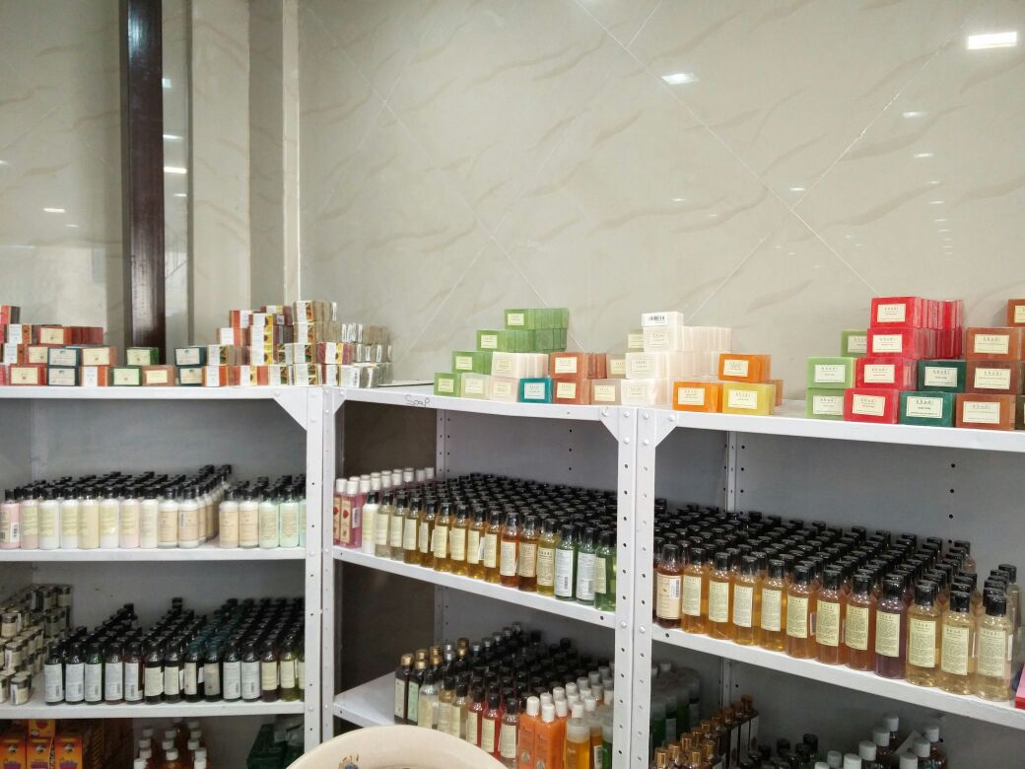
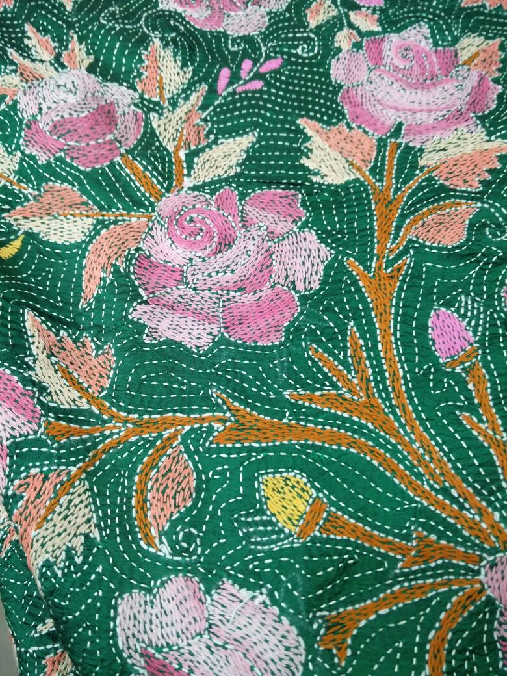
PRODUCTS MANUFACTURED AT KHADI

Slide 8
A BEE COMB MAINTAINED AT KHADI

Slide 9
Khadi’s ENVIRONMENTAL policy and aims:
Khadi follows a no-profit policy. It follows a policy of complete non-violence and eco-friendliness. It’s main aim is to provide employment to the villagers living in the rural areas who do not have any other source of livelihood. It gives employment to almost 50 lakh villagers. It is the most eco-friendly organization in India.
It also does not consume much energy in the form of electricity or otherwise. Khadi only uses a little bit of solar energy and a little water.
The fabric is very soft and heat absorbing. It keeps us warm in summer and cool in winter.
It is the only organization allowed to make the National Flag of India.
KHADI OUTLETS AND MARKETING ABROAD:
In the beginning, Khadi had only 17 outlets. Now, it has increased to 7050 sales outlets all over the country. Hand-made paper manufactured by them is being exported to foreign countries like America, Europe, Canada, Saudi Arabia, etc. It has 60 directorates.

Slide 10
THANK YOU!
All in all, the visit to Khadi Gram Udyog was a very pleasant one. It truly is an ecological company and does a lot to manufacture it’s products in an eco-friendly way. The visit was a very enjoyable and educational experience.

