Slide 1
EUMIND 2016
Action Plan

Slide 2
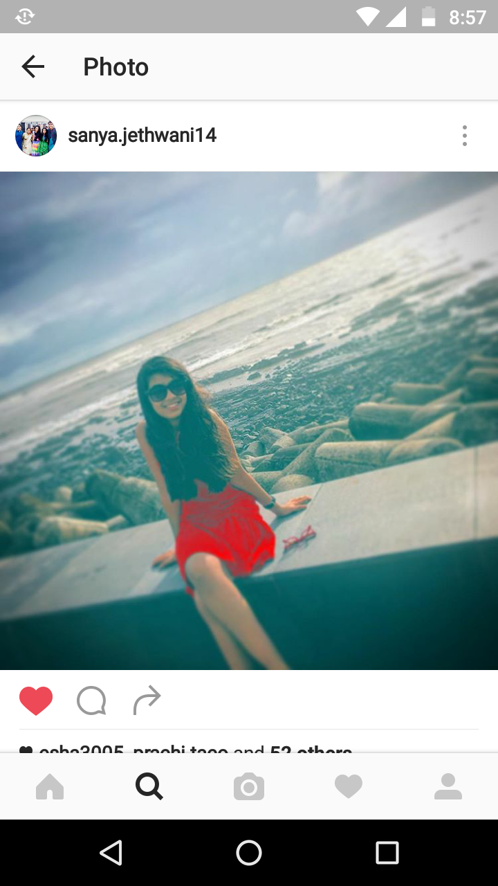
Name : sanya
Age: 14 years
role: editor weebly
Hobbies: singing and dancing

Slide 3
Name: yutieka
Age: 14 years
role: writing text articles,
Analyzing outcomes of interviews
Hobbies: dancing and dRawing

Slide 4
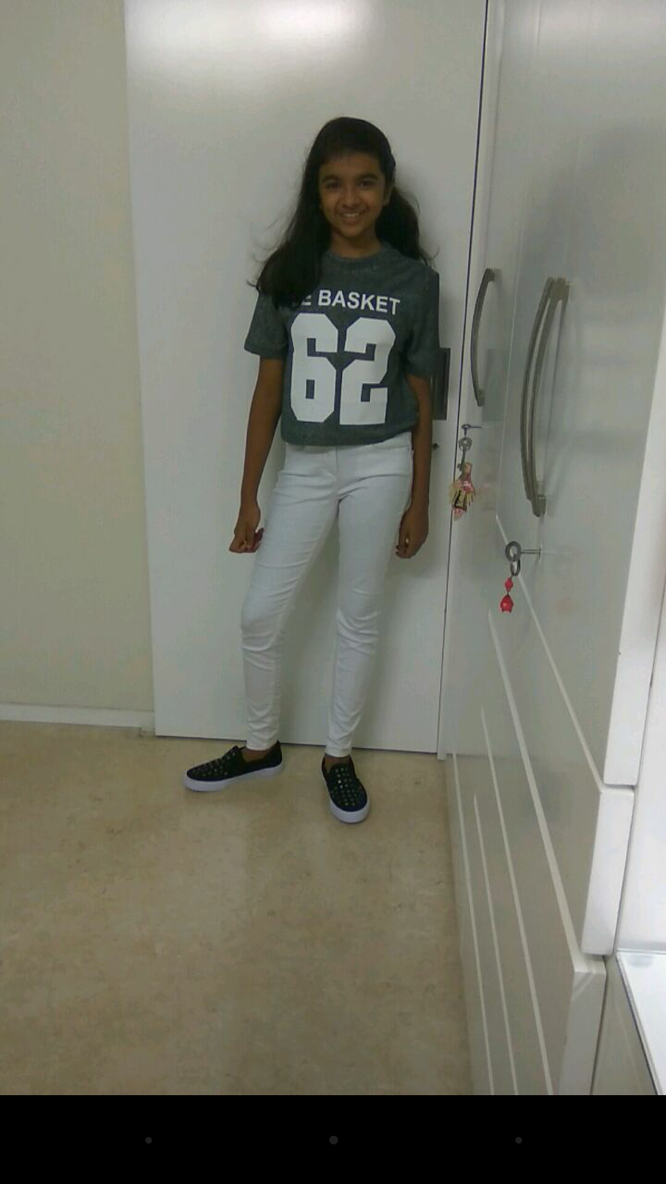
Name: sanjana
Age : 14 years
Role: interviewing and comparing
Hobbies: singing , dancing and playing sports

Slide 5
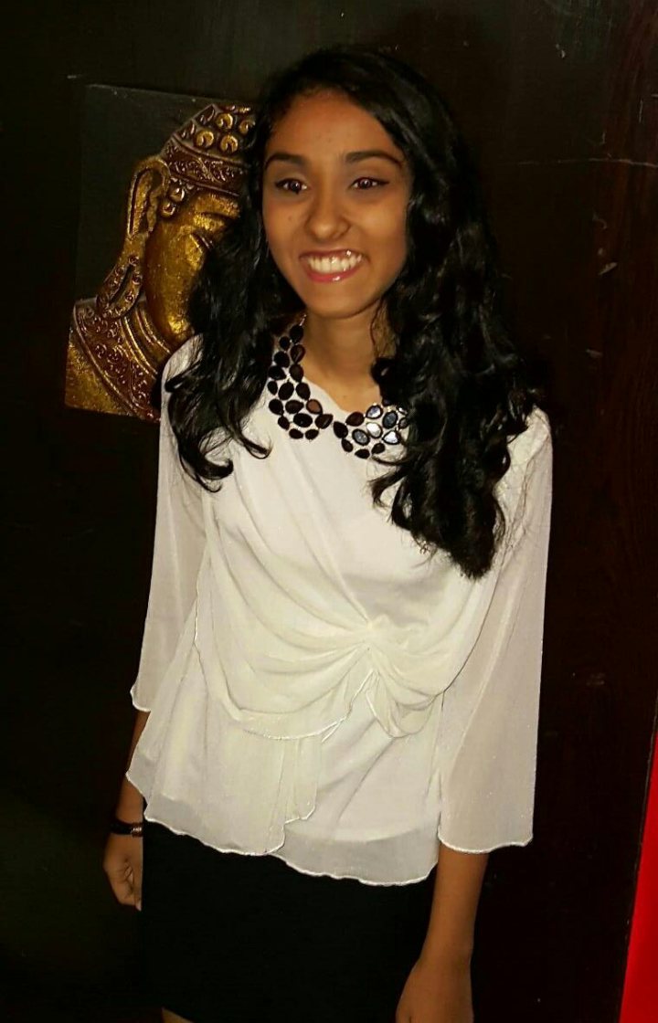
Name: mehek
Age: 14 years
Role : main photographer
Hobbies: drawing and playing with animals

Slide 6
Name: urvi
Age: 14 years
Role : group leader, main video editor
Hobbies: singing, reading and creative writing

