Slide 1
Action Plan
EUMIND (2016-17)
Jasudben M. L. School
Std. IX
Topic: Ecological Companies [Go Green]

Slide 2
Why we chose this topic?
The main reason we chose this topic is that we are curious to know how the companies in Mumbai function with keeping in mind our environment’s safety.
We found this topic the best and the most interesting one out of all.

Slide 3
Duties
Name | Task
Krish | Leader/Editor
Riddhant | Photographer
Krisha | Artist
Aashna | Interviewer
Dhruvi | Compere/Report Writer

Slide 4
What are we going to do?
We are going to research about companies and the measures that they are taking to implement a more eco-friendly policy and to attract more customers.

Slide 5
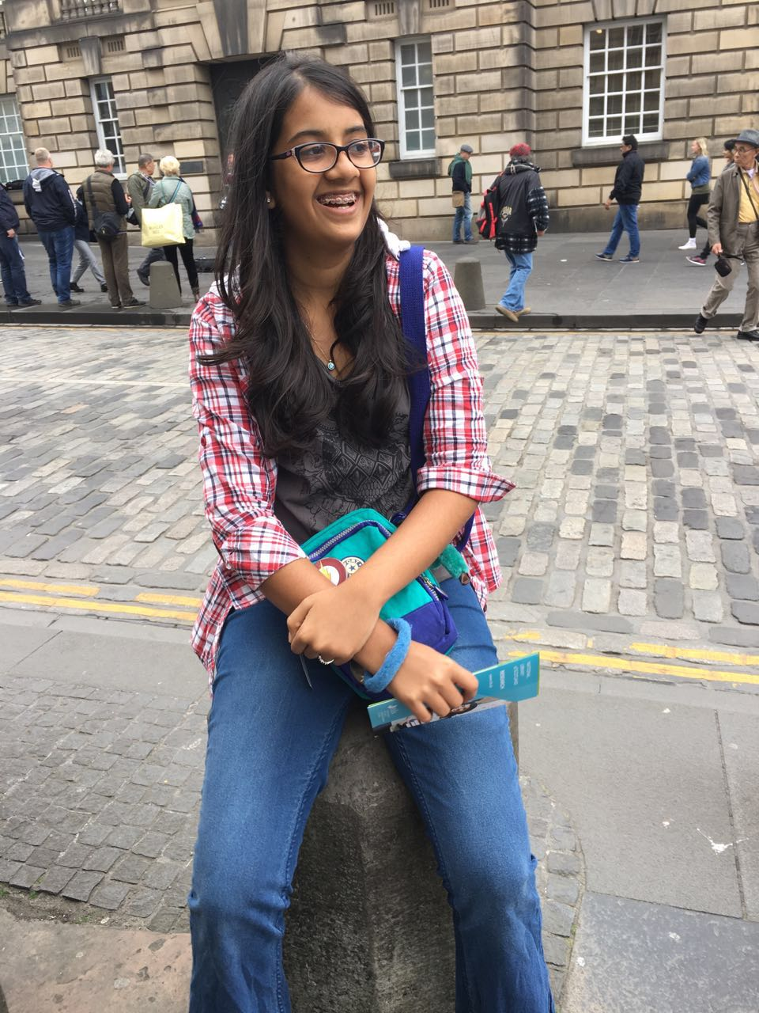
Krisha
Role: Taking care of the art related things.
I love reading, writing and drawing. I enjoy dancing and listening to music I love to read romance novels. I want to pursue in Literature or Arts.
My friends think of me to be passionate caring and generous.
I will be in charge of all the drawings and will be coordinating with the companies we will be interviewing.

Slide 6
Riddhant
Role: I am in charge of photography.
I love gaming and my favourite sport is soccer.
I want to become a film-maker.
My dream is travel around the world.
I am a person who believes in hard work.
I will mainly be clicking photos for our projects and will be in charge of shooting the videos of our interviews.

Slide 7
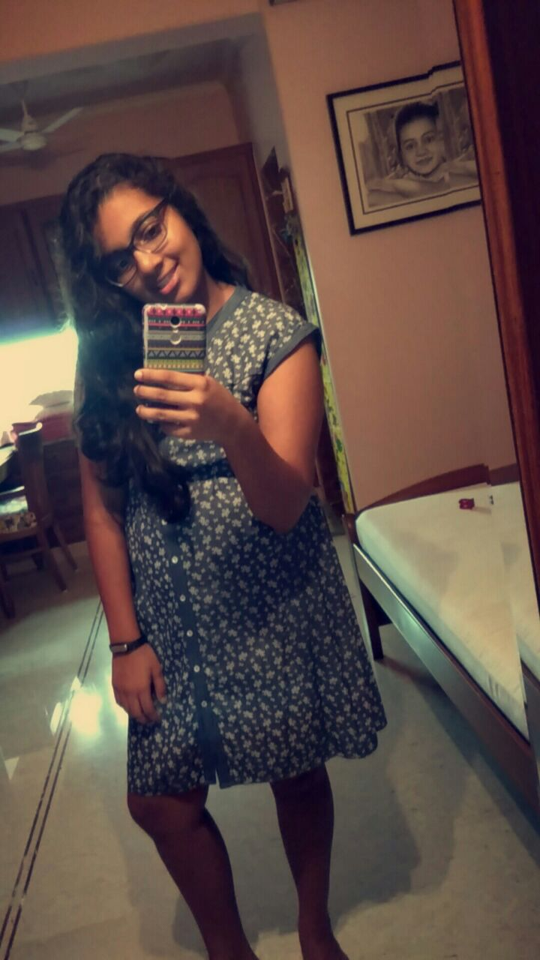
Dhruvi
Role: I am the comparer and I will be writing reports.
I love playing sports and I like dancing and music.
I have a lot of confidence and like imitating people and take their opinions.
My friends think I am confident caring and sportive.
My main duty is to host the interviews and to write reports.

Slide 8
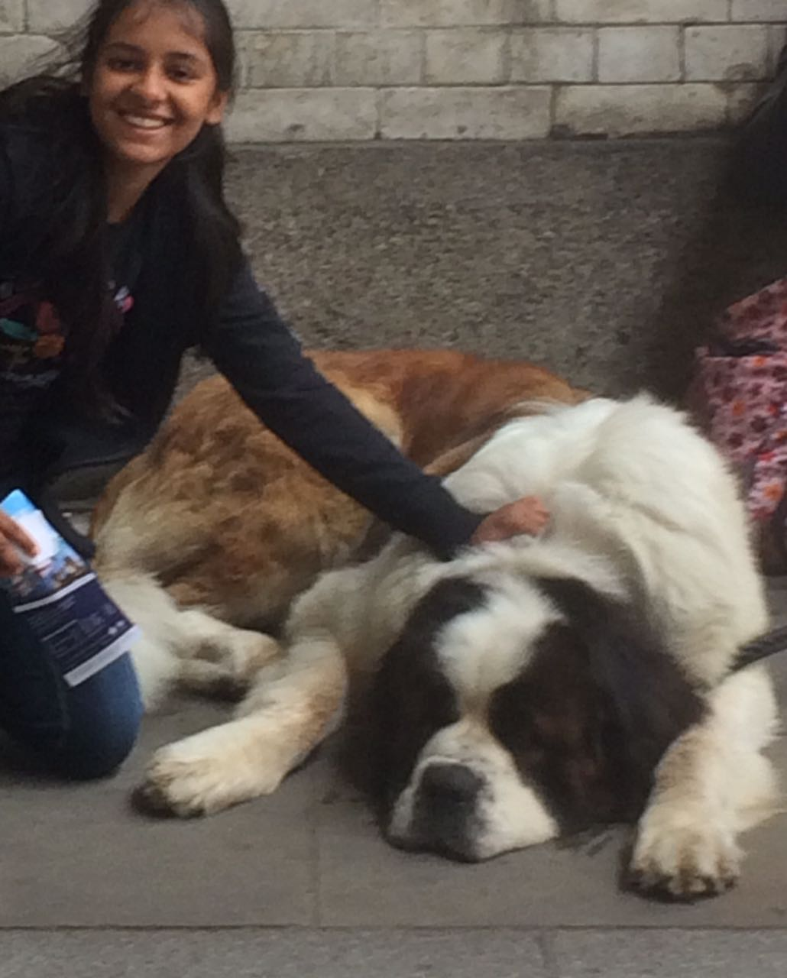
Aashna
Role: Interviewing
I love social work. I Love art. I love music. I Love dancing.
I love watching movies. I love philosophy and all sorts of research, especially religion.
Adrenaline junkie. Love trying ailments from all over the globe. I love travelling. I would like to pursue in art or grow up to be a communist/socialist.
My main aim is to interview the people of the companies.

Slide 9
Krish
Role: Leader/Editor
I love software programming and would love to pursue in software engineering. I am learning Java (programming language).
I love watching television and movies. I love listening to music. My friends think of me to be helpful, kind and caring.
I am experienced in Adobe Photoshop – and will mainly be in charge of editing our photos, videos and our presentations. I will ensure that all our articles, presentations are error free.

Slide 10
Our Group!

Slide 11
We are looking forward to work with everyone and to enjoy doing our tasks, duties & projects.
THANK YOU ☺

